Slide 1



Department of Computer Science & Engineering
Chhattisgarh Swami Vivekanand Technical University
Bhilai (India)
Major Project Presentation
on
Multi-Disease Prediction using AI & ML
Submitted by:
Haris Rahman (301202223027)
Raipur Institute of Technology,Raipur
Chhatauna,Mandir Hasaud , Raipur (C.G.),India - 492101
Phone :91-0771-3250790 ,3208824 Fax:91-0771-2537634
Email:contactus@rit.edu.in, Website:www.rit.edu.in

Slide 2


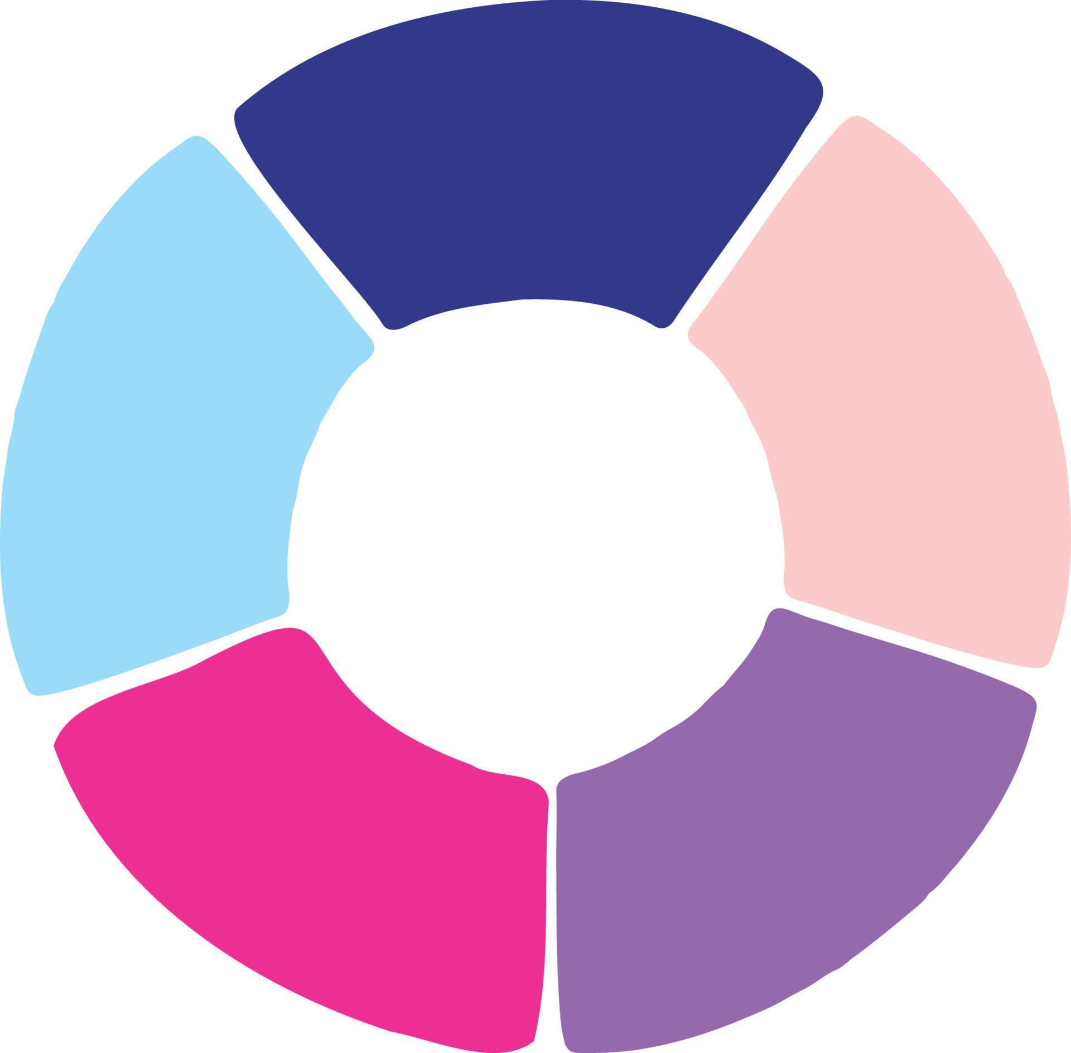
Project Overview — MediPredict AI
Problem statement
Objectives
Need & Expected benefits
Late or missed diagnosis across multiple diseases due to fragmented data and limited screening in low-resource settings.
Build an integrated web tool for multi-disease prediction
Deliver accurate, fast predictions with clear recommendations
Ensure secure, accessible patient-facing interface
Early detection improves outcomes
Reduce clinician workload, speed triage
Support rural and telehealth screening

Slide 3
Existing System vs Proposed System
Limitations of traditional diagnosis
Advantages of MediPredict AI
Manual review causes delays
Inconsistent interpretation across clinicians
Poor access in rural clinics
No unified multi-disease screening
Automated, repeatable predictions
Multi-disease support (heart + kidney)
Web interface for clinicians & patients
Fast inference, exportable reports
Aspect
Traditional
MediPredict AI
Speed
Slow (manual)
Fast (seconds)
Consistency
Variable
High (model-driven)
Scope
Single-disease focus
Multi-disease

Slide 4
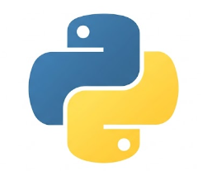

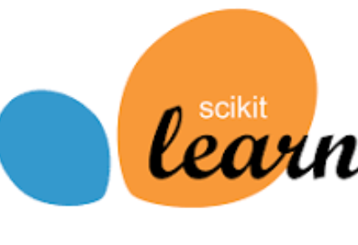



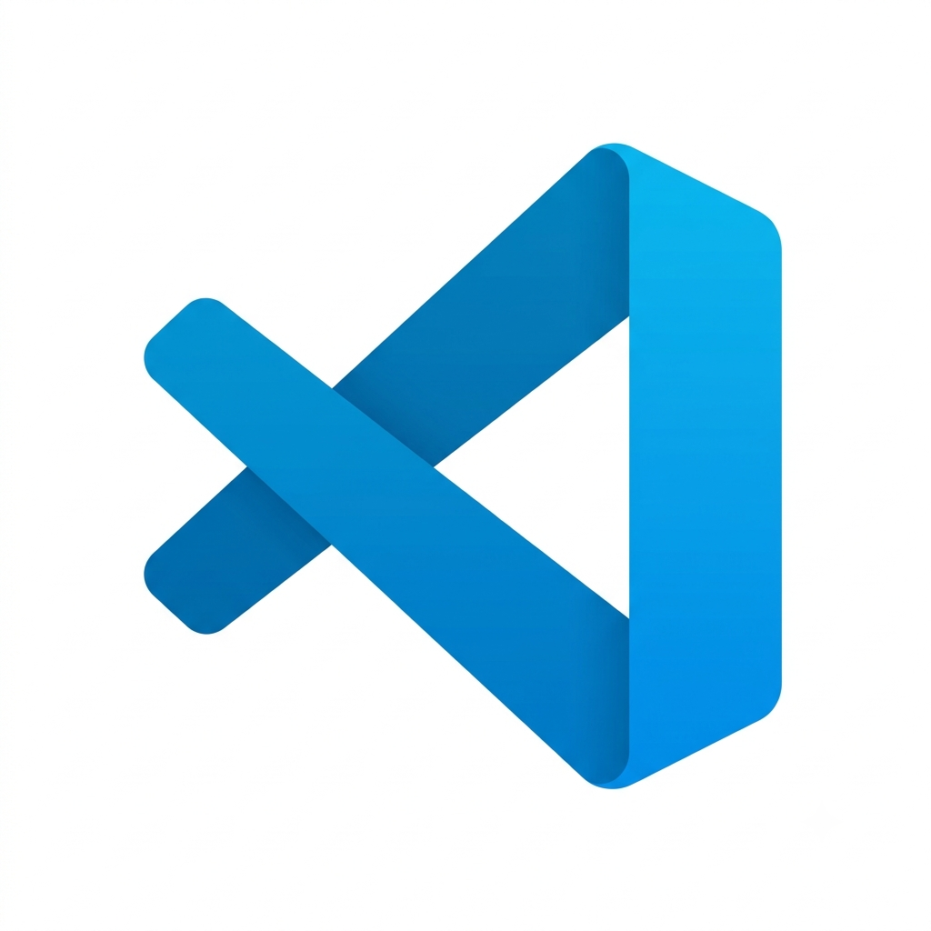
Technologies Used
Python
Flask
Python is the core programming language used to develop the MediPredict AI system. It handles data preprocessing, machine learning implementation, and backend logic. Its simplicity and extensive libraries make development efficient and reliable.
Flask is a lightweight Python web framework used to build the backend of the application. It connects the frontend with the trained machine learning models, processes user inputs, and returns prediction results through web requests.
HTML / CSS / JavaScript
Scikit-learn
HTML, CSS, and JavaScript are used to create the frontend of the application. HTML provides the page structure, CSS enhances the visual design, and JavaScript adds interactivity and form validation for a better user experience.
Joblib is used to save and load trained machine learning models efficiently. It enables the application to reuse the trained models without retraining them, resulting in faster and more consistent predictions.
Pandas & NumPy
Joblib
Pandas and NumPy are essential Python libraries for data analysis and preprocessing. They are used to clean, organize, and manipulate datasets while performing efficient numerical computations required for machine learning.
Joblib is a Python library used to save and load trained machine learning models efficiently. It enables the application to use the trained model without retraining it every time. This reduces loading time, improves performance, and ensures consistent prediction results.
Git & GitHub
VS Code
GitHub is used for version control and project management throughout the development process. It stores the source code securely, tracks changes, and simplifies collaboration and project maintenance.
Visual Studio Code is the primary development environment used for this project. It provides support for Python, Flask, HTML, CSS, and JavaScript, along with debugging tools and extensions that improve development productivity.

Slide 5
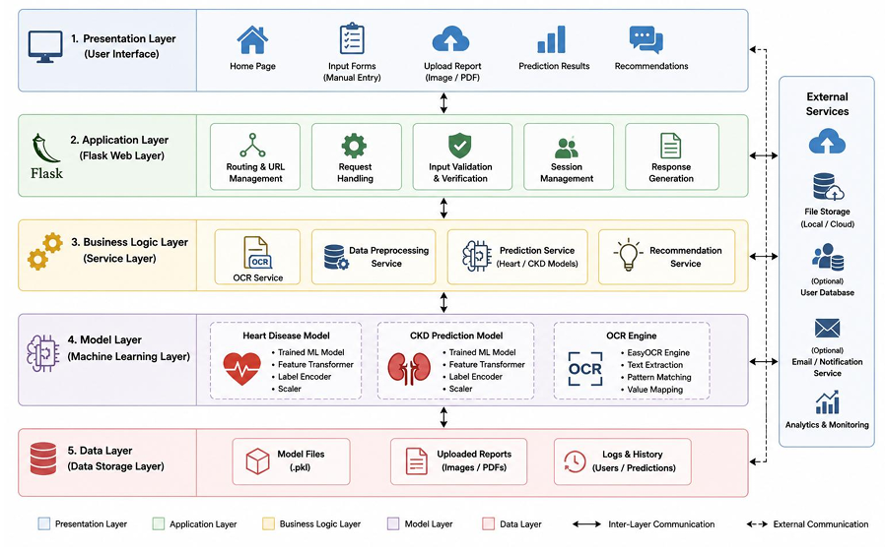
User Interface: Users enter patient details through a responsive web application developed using HTML, CSS, and JavaScript.
Backend Processing: Flask receives the input, validates the data, and communicates with the machine learning model.
Machine Learning Model: The trained model, loaded using Joblib, analyzes the input and predicts disease risk.
Result Generation: The prediction is displayed instantly on the web interface, enabling quick health assessment.
System Architecture
User
Web Interface
Flask Backend
ML Models

Slide 6
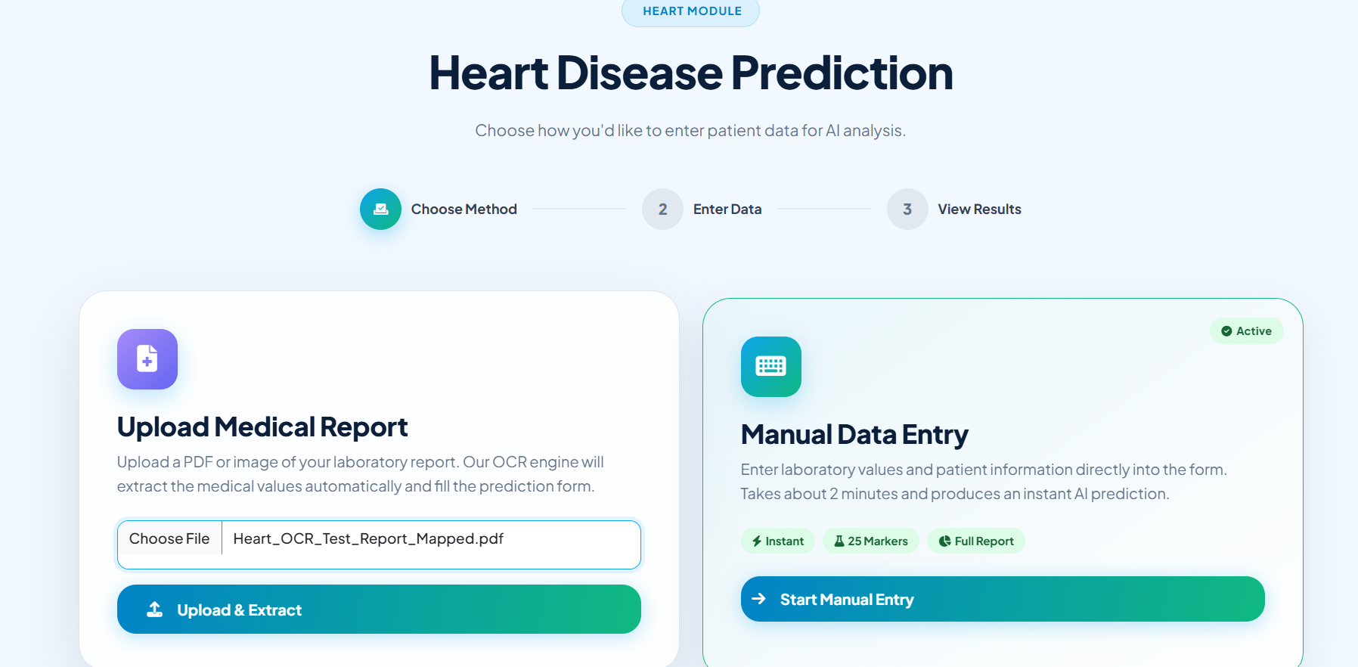
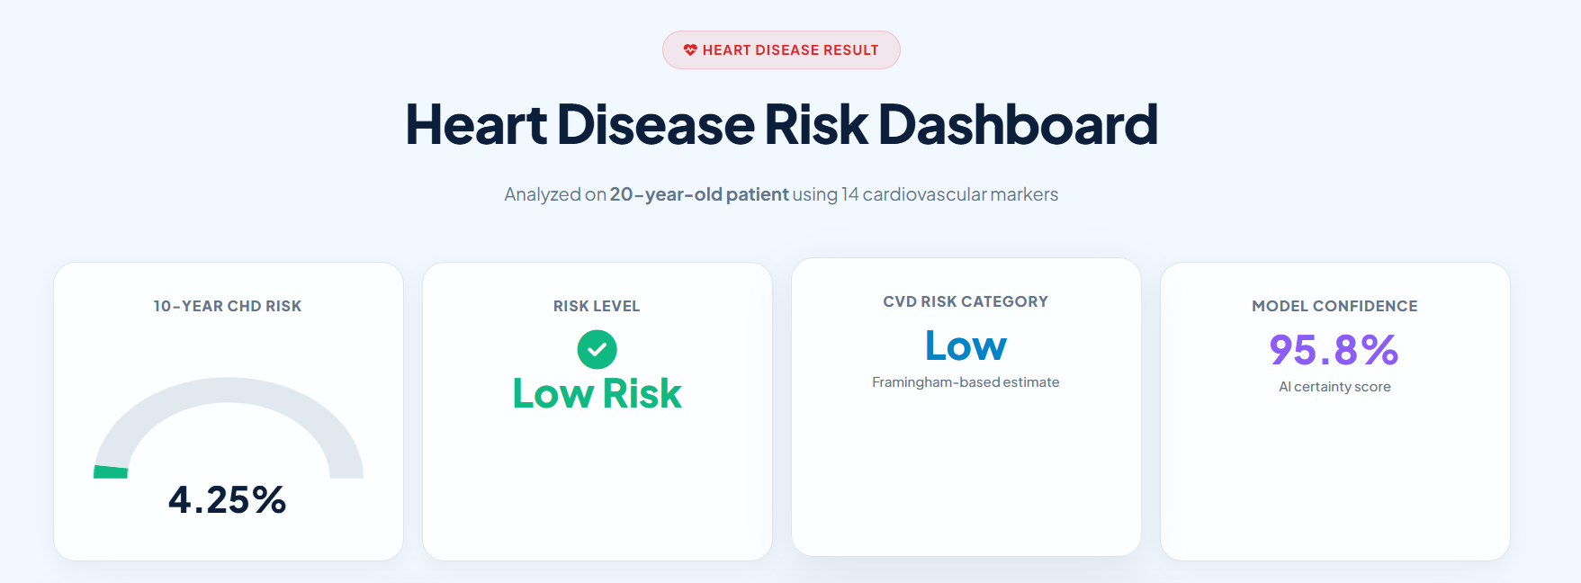
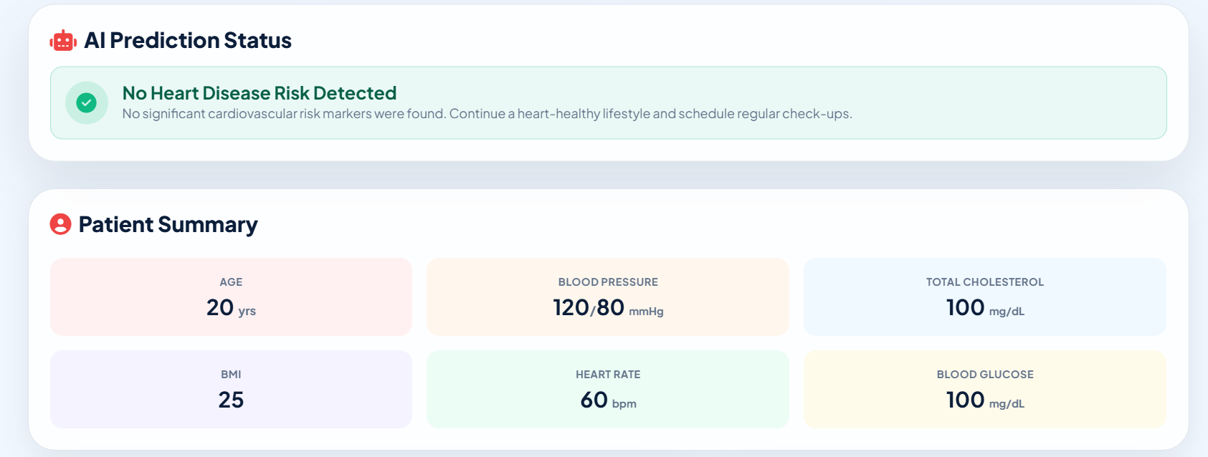
Heart Disease Prediction Module
Dataset overview
Input parameters
Model
Logistic Regression — calibrated, regularized
Public heart disease dataset — clinical features & ECG markers; N rows after cleaning
Age, Sex, Chest pain type
BP, Cholesterol, Fasting blood sugar
ECG results, Max heart rate
Output & Metrics
Binary risk prediction + probability
Accuracy: 0.92, ROC-AUC: 0.91 (cross-validated)

Slide 7
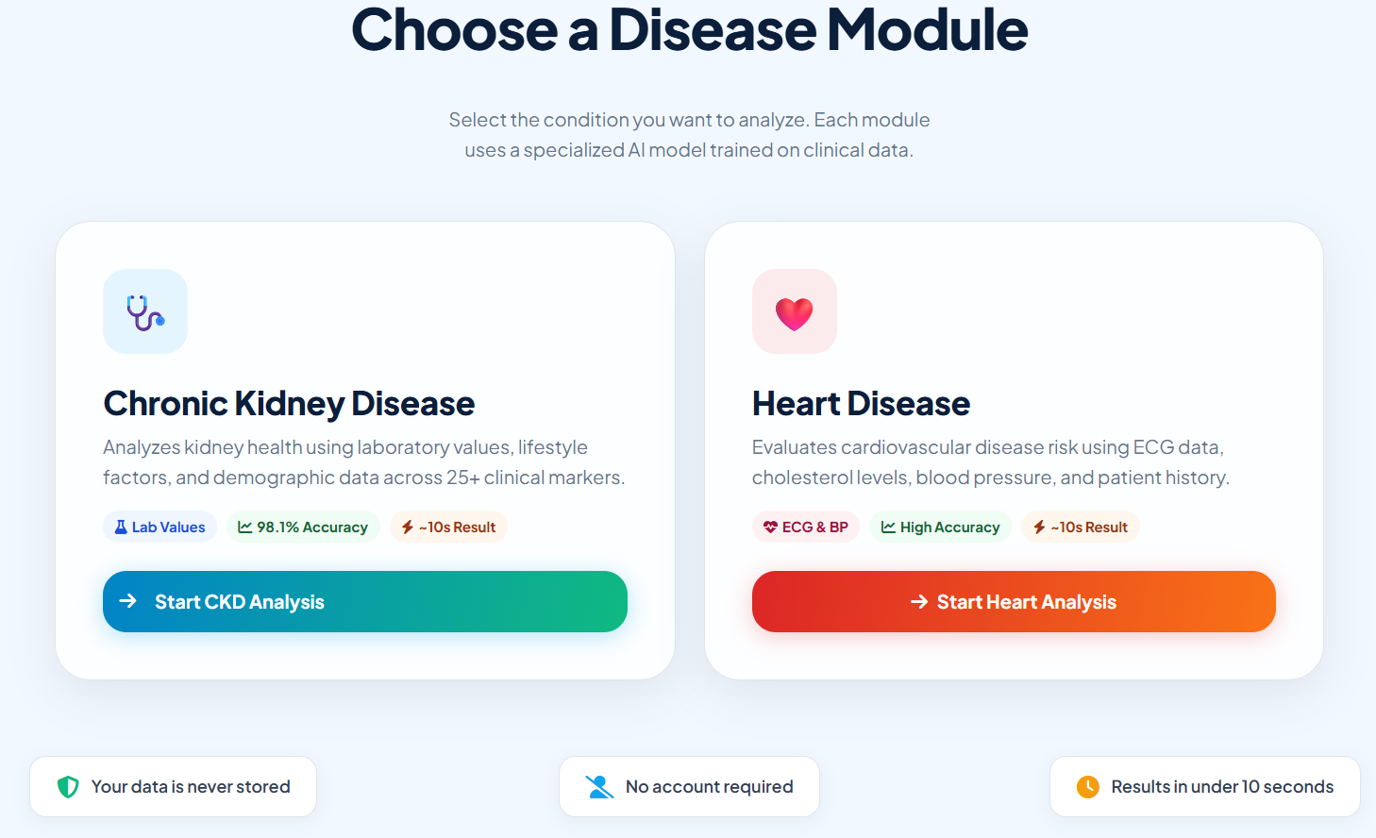
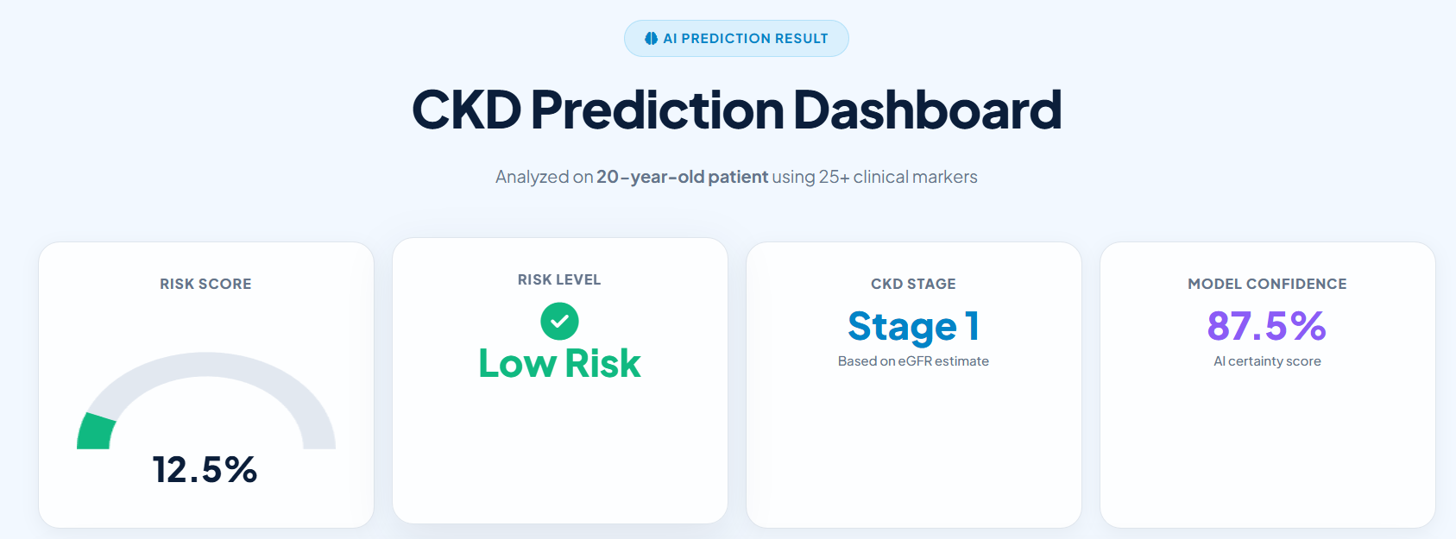
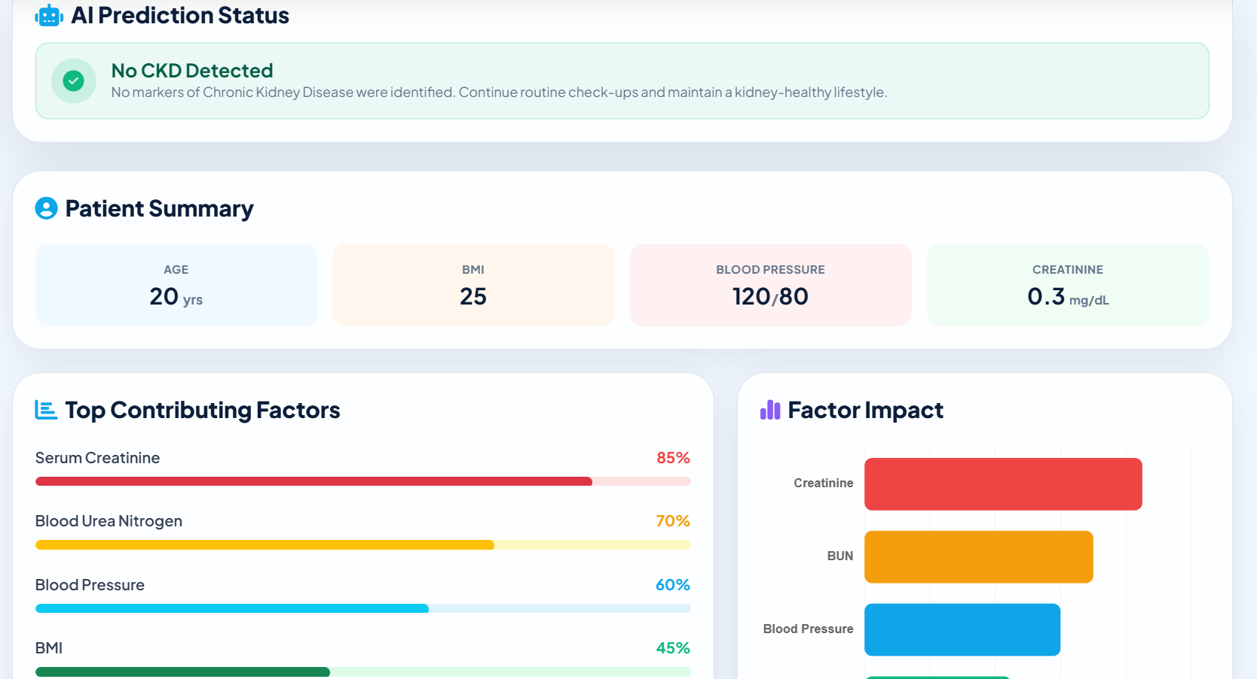
Chronic Kidney Disease Module
Dataset overview
Input parameters
Model
Random Forest — tuned with grid search, feature importance extracted
CKD dataset with lab tests (creatinine, urea) and demographic fields; cleaned & imputed
Age, BP, Specific gravity
Albumin, Sugar, Serum creatinine
Hemoglobin, Pus cell, Bacteria
Output & Metrics
Binary prediction + confidence
Accuracy & ROC-AUC reported (cross-validated)

Slide 8
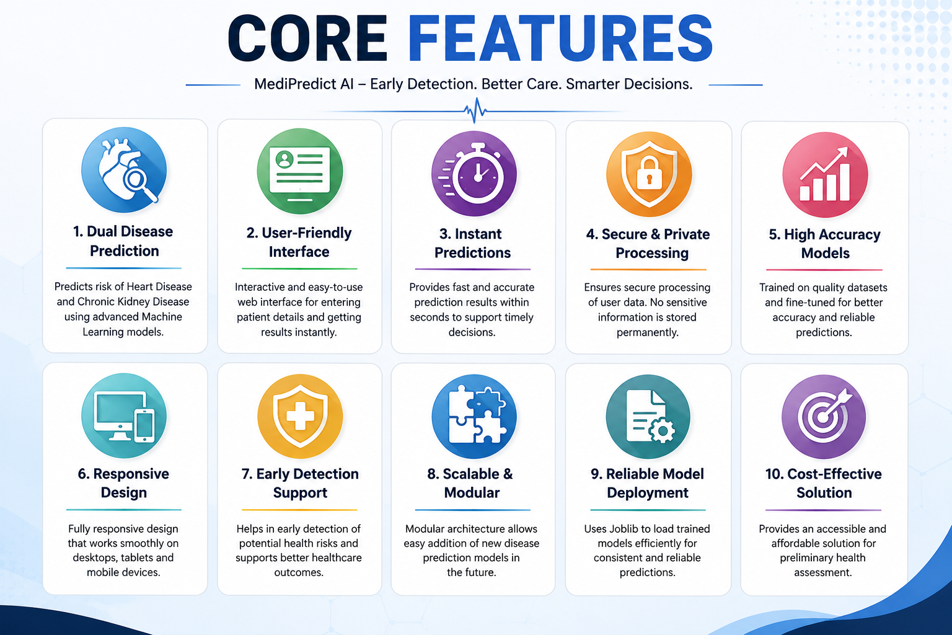
Application Features
Core features
•
Machine Learning-Based Analysis: Uses trained ML models to analyze patient health parameters and predict disease risk.
Secure Data Processing: Processes user inputs securely without permanently storing sensitive medical information.
Fast Response Time: Generates prediction results quickly, improving usability and efficiency.
Responsive Design: Works smoothly across desktops, laptops, tablets, and mobile devices.
Scalable Architecture: Designed to support additional disease prediction modules in the future.
Easy-to-Use Interface: Simple layout that enables users with minimal technical knowledge to use the system.
Reliable Model Deployment: Integrates trained models using Joblib for consistent and efficient predictions.
Input Validation: Validates user-entered data to reduce errors and improve prediction accuracy.
•
•
•
•
•
•
•

Slide 9
Results and Performance
Model Performance Comparison
Compares the performance of different machine learning models using standard evaluation metrics.
Metrics such as Accuracy, Precision, Recall, and F1-Score are used to assess model effectiveness.
The Random Forest model achieved the highest overall performance and was selected for deployment.
The comparison demonstrates the model's reliability and suitability for disease prediction.

Slide 10
Applications & Future Scope
Future Scope
Expand the system to predict additional diseases such as diabetes, liver disease, and stroke.
Develop a mobile application for easy access to health predictions anytime and anywhere.
Improve prediction accuracy by training on larger and more diverse medical datasets.
Enable integration with Electronic Health Records (EHR) and hospital management systems.
Incorporate Explainable AI (XAI) to provide clear reasons behind each prediction.
Add personalized diet, lifestyle, and medication recommendations based on prediction results.
Deploy the application on a cloud platform to support real-time access and scalability.
Applications
Healthcare Centers: Assists doctors in the early screening of heart and kidney diseases.
Hospitals & Clinics: Supports quick preliminary risk assessment before detailed medical diagnosis.
Telemedicine Platforms: Enables remote health monitoring and online disease risk prediction.
Health Awareness Programs: Promotes preventive healthcare through early detection and timely intervention.
Medical Research: Assists researchers in analyzing healthcare data and improving predictive models.
Educational Purpose: Serves as a practical machine learning application for healthcare and academic projects.

Slide 11
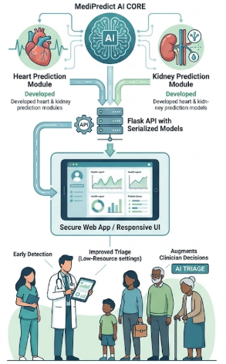
Conclusion
Summary
MediPredict AI integrates ML models into a secure web app to provide rapid, multi-disease screening.
Key achievements
Developed heart & kidney prediction modules
Deployed Flask API with serialized models
Responsive UI with clear reports
Real-world impact
Supports early detection, improves triage in low-resource settings, and augments clinician decision-making.
Final conclusion
MediPredict AI is a practical, extensible capstone system ready for pilot deployment and further extension.

Slide 12
Thank
YOU

